Slide 1
Unit-2
Networking with Java

Slide 2
Networking
Transmitting data from one device to another on the network using same protocol.
Two important Networking stacks:
    OSI Layer Networking Stack
    TCP/IP Layer Networking Stack
    TCP/IP Architecture is implemented on Internet & its basis is IP
    IP works on 3rd layer (Network layer) of TCP/IP Model.
    The application of IP is addressing hosts and routing data packets between them.

Slide 3
Internet protocol
Two versions of IP:
IPv4: 32-bit long address
IPv6: 128-bit long address
Network falls into five different classes. The class can be used to determine the number of host in the network of which it is a member.
Class A : 1 – 126 (16M hosts)
Class B : 128 – 191 ( 65536 hosts each)
Class C : 192 - 223 (256 hosts each)
Class D : 224 – 239 (addresses for multicasting)
Class E : 240 – 255 (addresses reserved for future use)
The class defines the network size of the organization.

Slide 4
Contd…
An IP datagram contains a header and a protocol data unit (PDU).
The header collections of information about fragmentation, length, time to live (TTL), and similar parameters.
The PDU contains the encapsulated data, which generally means a TCP segment or UDP packet.
TCP provides guaranteed data transmission at the destination host’s application because of its connection-oriented features.

Slide 5
Implementing servers
To implement networking in Java, java.net package classes are used that give access to IP address, and a range of methods related to TCP, UDP, and URL.
IO stream classes are also used to read and write data from and to communication channel.
A virtual-stream is provided by TCP, which supports IP connection across the network.

Slide 6
Contd…
Two important classes, participates in communication:
InetAddress class to provides IP address of target connection.
Socket class to creates TCP connection.
Once a connection has been created, we bind both ends of the socket with their streams, and communication will start by writing and reading data on these streams to and from remote application.

Slide 7
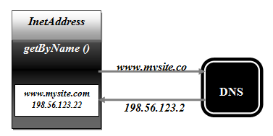
Class InetAddress
InetAddress provides an abstraction to access IP address
There is no constructor of this class.
The class provides some static methods to create the instance of the class, i.e. an object.

Slide 8
Methods of java.net.InetAddress class
static InetAddress getLocalHost() throws UnknownHostException
Method returns an object corresponding to the local machine.
static InetAddress getByName(String host) throws UnkownHostException
Method returns an object of the specified host host. The host can be a name (mysite.com) or by IP address (198.56.123.22)
static InetAddress[] getAllByName(String host) throws UnknownHostException
Methods return an array of objects corresponding to every known IP address for the specified host.
byte[] getAddress()
Method return an array of bytes corresponding to the IP address, under IPv4 this array will only be of four bytes and for IPv6, it will be eight bytes.
String getHostName()
Method returns the name of the host.

Slide 9
InetAddressDemo
public class InetAddressDemo
{
public static void main(String ar[])
{
InetAddress inet=InetAddress.getLocalHost();
System.out.println(“Local Host address is:” +inet);
InetAddress inam= InetAddress.getByName(“User-PC”);
System.out.println(“The Name is:” +inam);
}
}

Slide 10
import java.net.*;
class InetAddressTest
{
public static void main(String args[]) throws UnknownHostException
{
InetAddress Address = InetAddress.getLocalHost();
InetAddress SW[] = InetAddress.getAllByName("www.google.com");
for (int i=0; i<SW.length; i++)
System.out.println(SW[i]);
}
}

Slide 11
Class ServerSocket
ServerSocket class provides the facility by which a server accepts a connections request from clients across the network.
The class creates a Socket for individual client connection.
After socket creation, an InputStream and an OutputStream will be created for communicating with client.
The fundamental mechanism for implementing a server is to open a ServerSocket with a specific and certain local port number.

Slide 12
Class ServerSocket
The ServerSocket will start to wait for connections.
As client generates the request to connect to this port, the connection will be established.
ServerSocket is constructed by choosing a port on the local machine.
This port number should be in the range 1 – 65536.
Ports 1 – 1023 are reserved for system services and can be used only by the machine administrator.

Slide 13
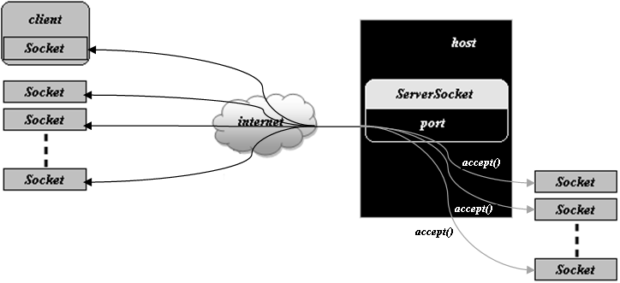
Server Socket

Slide 14
Contd…
A server accepts the explicitly connection request from a ServerSocket to obtain a client’s Socket connection.
As the ServerSocket is created, operating system started to accept the connections from clients, and insert in a queue, and delete one-by-one as the server call the accept() method.

Slide 15
Contd…
ServerSocket(int portNumber) throws IOException creates a ServerSocket object that listens on the specified port portNumber.
ServerSocket ssckt = new ServerSocket(1889);
This server can listen on port 1889.
ServerSocket(int portNumber, int countValue) throws IOException creates a ServerSocket that listen on the specified port portNumber and countValue specified the number of outstanding connection requests.
ServerSocket ssckt = new ServerSocket(1889, 40);
The ServerSocket constructor receive the value of number of connection that will be open and receive by the operating system which are stored in a queue.
Any connection requests more then given value will be discarded.
The default limit of queue is 50 to accept connection request.
This server can listen on port 1889, and have 40 outstanding connection requests.

Slide 16
Methods of java.net.ServerSocket class
Socket accept() throws IOException | Method waits until a client makes a connection request to the port on which this ServerSocket is registered or listening.
void close() throws IOException | Method closes the ServerSocket but will not close any connection which have been accepted by accept() method and not yet closed, and give instruction to operating system not to accept new client connections. It will maintain existing connected client connections.
int getLocalPort() | Method returns the port on which this ServerSocket is listening.

Slide 17
Class Socket
A Socket represents a TCP connection with a machine on network.
This class facilitate in establishing the stream-based channel with a remote machine.
The Socket class creates a socket and automatically establishes a TCP connection, and throws an exception if it fails.
Socket address is the combination of three components: host id, which can be referring with the host name, IP address, and the port number.
The port number is an integer value lie between 1 and 65536. In fact, on every host, there are 65536 different addresses.

Slide 18
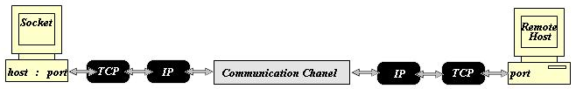
Socket

Slide 19
Constructors of Socket Class
Socket(String hostName, int portNumber) throws IOException creates a Socket object and connects to the given host on the given port number.
Socket sckt = new Socket(“mymac”, 1889);
Socket(InetAddress hostAddress, int portNumber) throws IOException creates a Socket object and connect to the given host address on the given port number.
InetAddress mac = InetAddress.getByName(“127.0.0.1”);
Socket sckt = new Socket(mac.getAddress, 1889);
OR
Socket sckt = new Socket(“127.0.0.1”, 1889);
Socket class methods provide the identification of remote host, port number of remote and local host, also give the stream for communication.
Create the Socket object to perform communications across a TCP connection.
Bind it with the required stream with the help of getInputStream() and getOutputStream() methods to communicate with the remote server.

Slide 20
Methods of java.net.Socket class
InputStream getInputStream() throws IOException | Method returns an InputStream that allow stream-based communications for TCP connections. The data written by a host at one end; can be read by remote host from this InputStream at other end of the connection. The method actually returns a SocketInputStream. The SocketInputStream is a nonpublic class.
OutputStream getOutputStream() throws IOException | Method returns an OutputStream that allow stream-based communication from TCP connection. The data written to this stream by any machine at one end; will be read by remote host at the other end of connection. This OutputStream should be buffered.
void close() throws IOException | The method is used closed the Socket, releasing all network and system resources being used. The data, which have been sent before this the call of this method, will be successfully delivered to the remote end, if there is no network fault.
InetAddress getInetAddress() | Method returns the IP address of the remote host.
int getPort() | Method returns the port number of the remote host to which the Socket is connected.
int getLocalPort() | Method returns the local port number, i.e., the port number of the Socket itself. Every TCP connection in fact consists of IP address and port number of local machine; and IP address and port number of remote machine, which will generally be different. A random and unused port number is assigned to Socket at its creation time.

